Slide 1

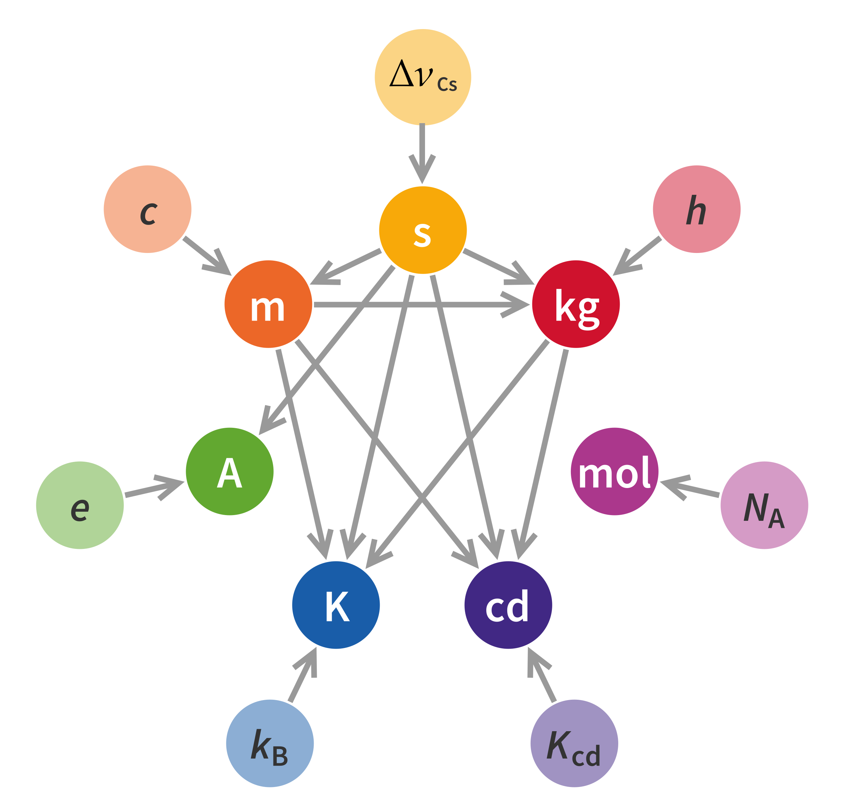
International System of Quantities library in VDM
The 21st Overture Workshop
10th March 2023
Leo Freitas
School of Computing, Newcastle University
Notes:
* NPL defined base units and standard conversions

Slide 2
Introduction
Most used system of measurements across multiple disciplines
Elegant, minimal and coherent
Seven base units, and new user units are coherent derivations
Formal representation of these units is important
Reduced error-prone and tedious calculations
History: used for personalised medicine application conversions
Notes:
Prescription given as 8mg of medicine X every 8 hours for 3 weeks
Yet BNF (British National Formulary) given as 2.4g of X every 24hrs per month

Slide 3

Base Units
Quantity | Symbol | Dimension | SI Name | SI Symbol
Length | l | L | metre | M
Mass | m | M | kilogram | kg
Time | t | T | second | s
Electric Current | I | I | ampere | A
Thermodynamic Temperature | T | Ɵ | kelvin | K
Amount of Substance | n | N | mole | mol
Luminous Intensity | I_{v} | J | candela | cd
Notes:
SI = Standard Internationalle
Mention original work with NPL

Slide 4
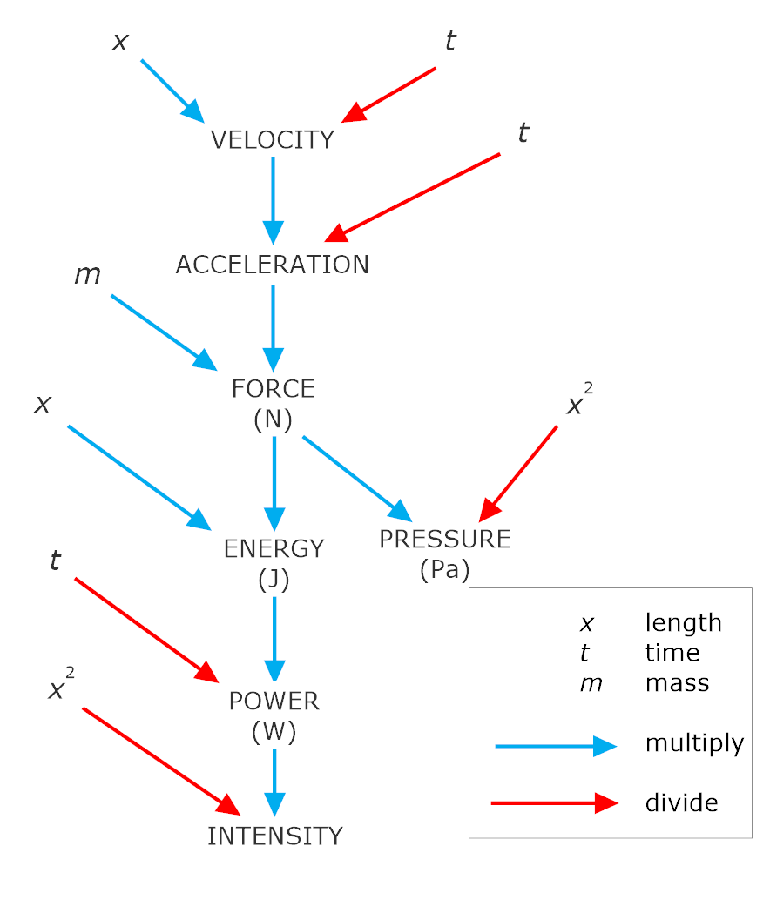
Derived Units
ISQ Base Unit Relationships
ISQ Unit Combination and Conversion
Notes:
ISQ are base unit relationships

Slide 5
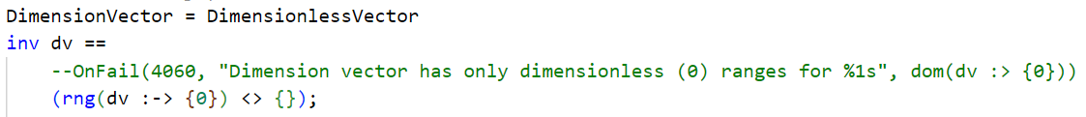
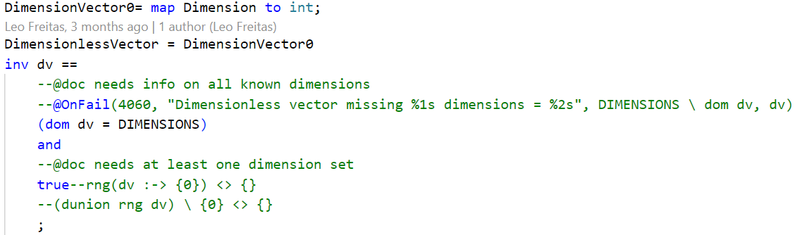
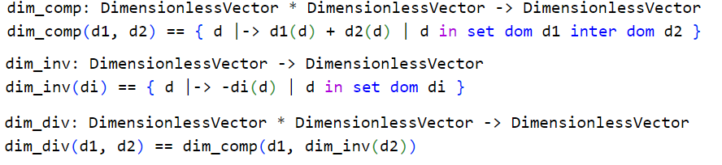
Dimension Vector
Map of each quantity dimension (or unit) in terms of its relations with other quantity base units (1)
Enables representation of derived units through base unit conversions (e.g. 1km = 1000m)
Most common dimensions (7 base and 15 derived) are predefined
Dimensionless vectors (dimension mapped to zero) define pure quantities (e.g. radians) (2)
Operators exist to combine and manipulate (e.g. multiply, invert, etc.) derived dimensions (3)
1
2
3

Slide 6
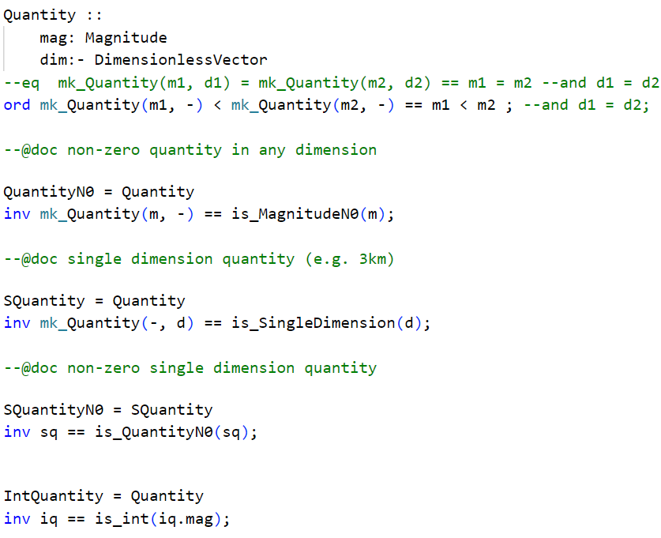
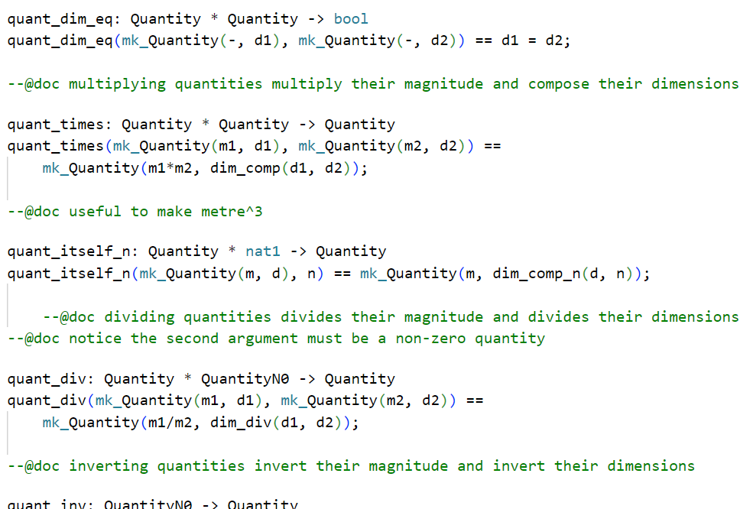
Quantities
Represents magnitude of a dimension
Used for conversion between different measurement systems (SI x BIS)
Comparison and ordering within same dimension
Quantities are real typed
Different varieties defined (1)
Integer magnitudes
Single dimension quantities
Several operators for quantities (2)
Multiplication
Subtraction
Replication
Etc.
1
2
Notes:
SI = length=m, temperature=celcuis, mass=kilogram, etc
BIS = length=yard, temperature=rankine, mass=pound etc

Slide 7
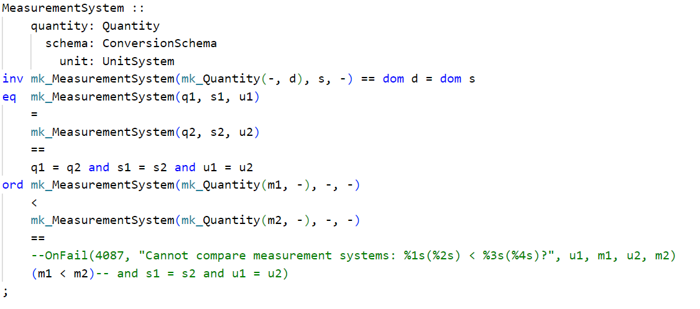
Measurement Systems
1
Group of quantities with specific dimensions and conversion schemas (1)
Measurement systems are defined for all dimension (base or derived)
Conversion schemas define how conversion between dimensions of different measurement systems can be done (2)
SI conversion schema = identity map
BIS conversion schema (3)
2
3

Slide 8
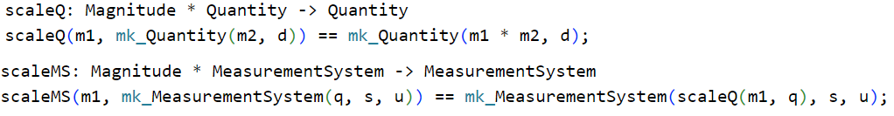
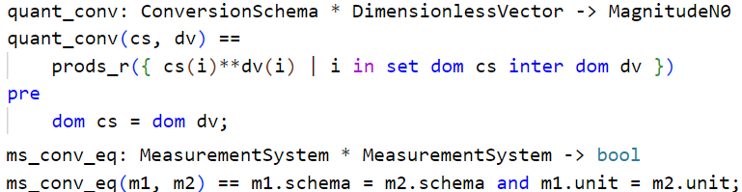
Scaling and Conversion
Scaling is the product of magnitudes
Scaling two quantities ignores dimension vectors, unlike scaling measurement systems
Scaling takes dimension vector of leading entity (e.g. km/h * miles/h results in km/h)
Converts magnitudes using the given conversion schema
Quantity conversion uses set product of integer exponents for corresponding schemas, where zero dimensions vanish
Be aware of potential real precision issues

Slide 9
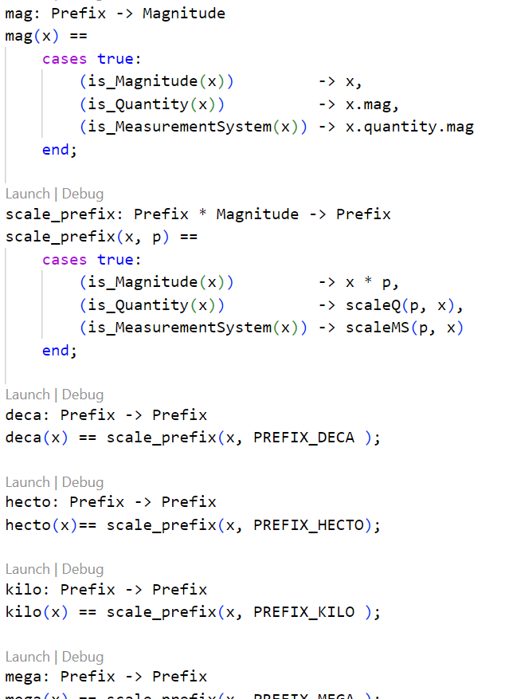
Common Prefixes
Prefix enable ease of (re)use
Prefixes work on
Measurement systems
Quantity
Magnitude
Uses VDM Union types to reduce duplication of code

Slide 10
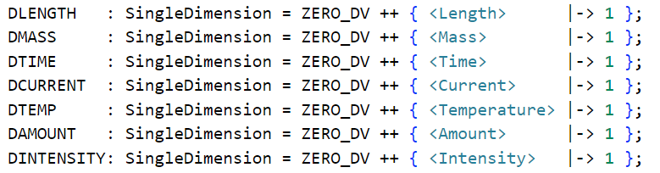
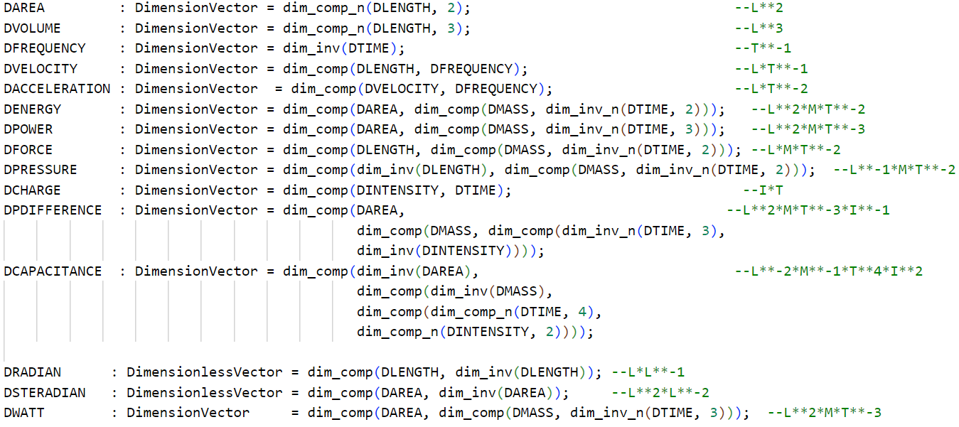
Example: Dimensions
Basic Dimensions
Pure Quantities
Derived Dimensions
Notes:
* Pure quantities are those that have dimensions cancelled out

Slide 11
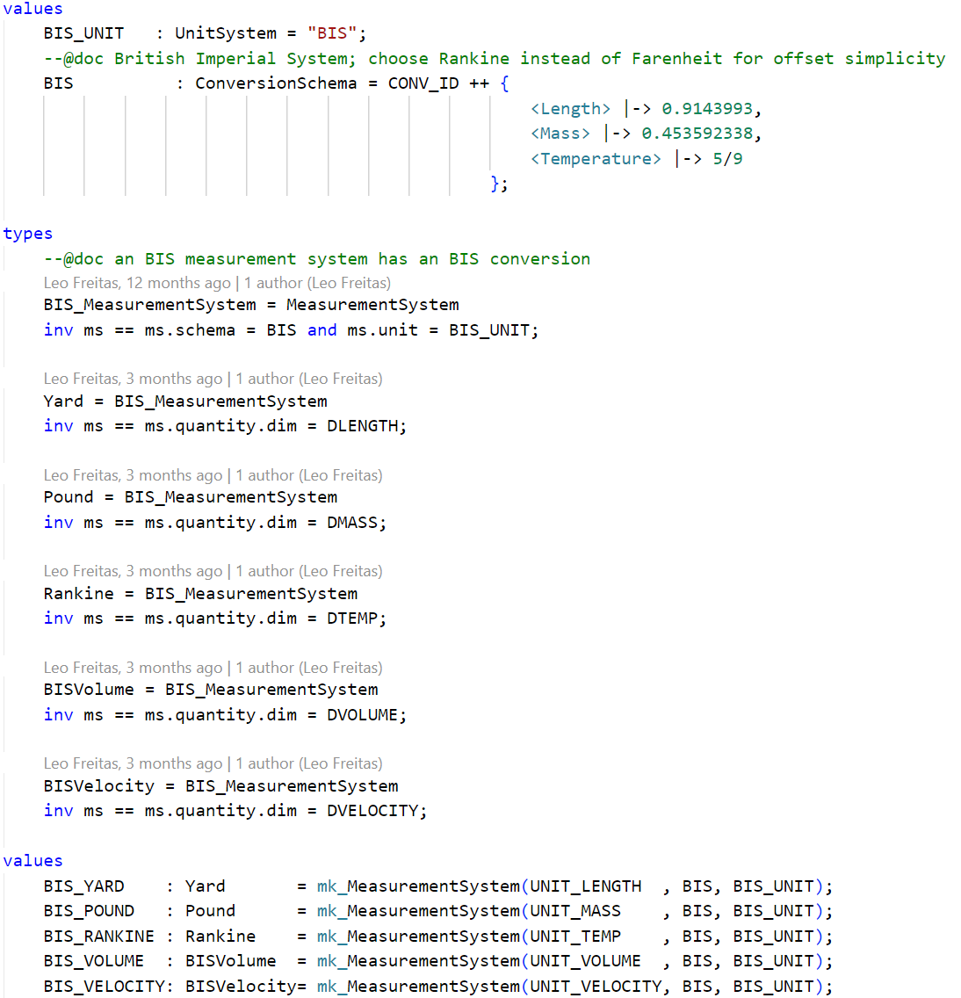
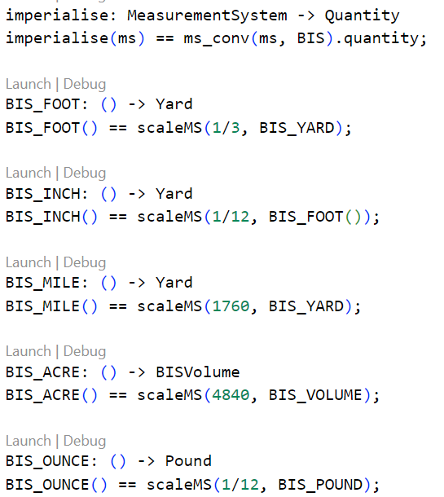
Example: British Imperial System (BIS)
Conversion Schema
General Conversion Function
Measurement System Types
Scaling Functions
Measurement System

Slide 12
Additional Notes
Alternate non-decimal systems (British Imperial) or Date/Time, etc.
Common constants (e.g. speed of light, Planck, Avogadro, etc.)
Equivalent quantities in different dimensions are demonstrated
Checking functions for creation of new / corresponding quantities (e.g. pressure per volume = energy; Pa*m³ = Joule = kg*m²/s²)
ISQ library works with VDMJ high precision
Approximation functions needed for high-precision calculations

Slide 13
Checking functions example
> script ./src/main/resources/ISQ.script
p let PA = ms_div(KILOGRAM, SI_ACCELERATION) in
mk_(is_Pressure(PA), si_dim_view(PA))
= mk_( false, "( kg (s**2) ) / m ")
p let PA = ms_div(KILOGRAM, ms_times(METER, ms_itself_n(SECOND, 2))) in
mk_(is_Pressure(PA), si_dim_view(PA))
= mk_( true, "kg / ( m (s**2) )")
p let EPV = ms_times(PA, SI_VOLUME) in
mk_(is_Energy(EPV), si_dim_view(EPV))
= mk_( true, "( (m**2) kg ) / (s**2) ")

Slide 14
Origins and Applications
Originally motivated by personalised medicine work
Prescription given as 8mg of medicine X every 8 hours for 3 weeks
Yet BNF (British National Formulary) given as 2.4g of X every 24hrs per month
High precision smart contract calculations
Solidity smart contract DSL for financial instrument conversions
Potentially useful for FMI FMUs?
Conversion between various physical quantities
Inspired by corresponding Isabelle/HOL implementation by S. Foster.

Slide 15
Future Work
Exploring use into industrial applications
Expanding list of units defined to include
All units in the SI tables
Physical quantities list
Further examples within industrial applications

Slide 16
Thanks for Listening

